Slide 1
Identify and Recognize Person Using Iris Biometric Security System
Supriti Ghosh
Class Roll: 11
Exam Roll: 160011
M.Sc 1st Semester
Session: 2015-16
Supervisor:
Dr. Mohammad Abu Yousuf
Assistant Professor, IIT, JU

Slide 2
Abstract:
A biometric system provides special and automatic identification of an individual based on characteristics and unique features showed by individuals.
The iris recognition system consists of the iris acquisition system and iris authentication algorithm.
This method will also able to localize the pupil region and circular iris, occluding eyelashes and eyelids, and reflections.
The performance will be measured for stored database which is scored 0% each for FRR and FAR.
Iris recognition is shown to be an accurate and reliable biometric technology.

Slide 3
Introduction:
Iris recognition is a method of biometric identification and authentication that use pattern-recognition techniques based on high resolution images of the irises of an individual's eyes .
It is considered to be the most accurate biometric technology available today.
The iris is a thin circular diaphragm, which lies between the cornea and the lens of the human eye.
The iris is perforated close to its centre by a circular aperture known as the pupil.
The function of the iris is to control the amount of light entering through the pupil.
The average diameter of the iris is 12 mm, and the pupil size can vary from 10% to 80% of the iris diameter [2].

Slide 4
Objective:
The main objective is build a learning framework for biometric security which will:
Recognize iris
Enhance the recognition by storing and learn classifier
Iris will track human and follow

Slide 5
Background:
The concept of Iris Recognition was first proposed by Dr. Frank Burch in 1939.
It was first implemented in 1990 when Dr. John Daugman created the algorithms for it.
These algorithms employ methods of pattern recognition and some mathematical calculations for iris recognition.

Slide 6
Purpose:
ATMs
Computer login: The iris as a living password
National Border Controls
Driving licenses and other personal certificates
Birth certificates, tracking missing
Credit-card authentication
Anti-terrorism (e.g.:— suspect Screening at airports)
Secure financial transaction (e-commerce, banking)
Internet security, control of access to privileged information

Slide 7
Methodology:
Iris Segmentation
Image Acquisition
Transformation
Eye Image
Iris Region
Principal Component Analysis
Identify or Reject Subject
Identify or Reject subject
Classifier
Steganography
Iris Template
Iris Templates Database

Slide 8
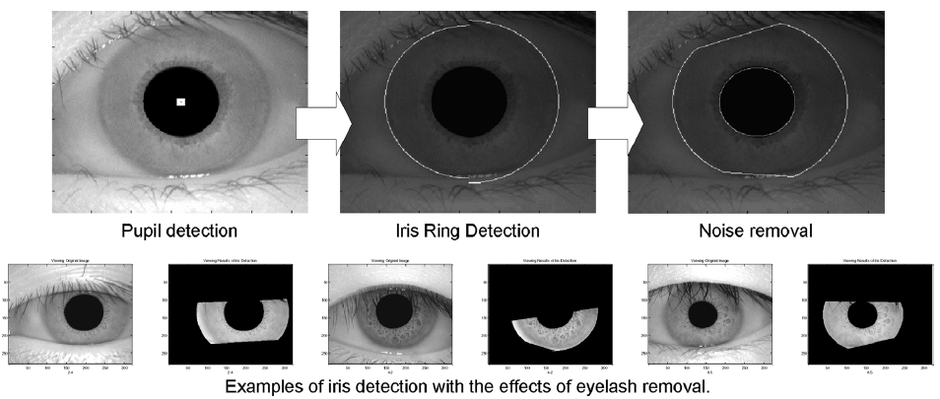
Hypothesis:

Slide 9
Limitations:
Accuracy changes with user’s height ,illumination , Image quality etc
Person needs to be still, difficult to scan if not co-operated
Risk of fake Iris lenses
Alcohol consumption causes deformation in Iris pattern
Expensive

Slide 10
Reference:
1] Malathy, C., A.K. Sadiq and K. Annapurani, “An Innovative Approach for Person Identification by Detection and Extraction of Optic Disc from Retina and Concha from Ear” Journal of Computer Science, Vol. 4, India.
[2] Yong Zhu, Tieniu Tan and Yumbog Wang, "Biometric Personal Identification Based on Iris Patterns." Pattern Analysis and Machine Intelligence, IEEE Transactions on 33.11 (2011): 2188-2202.
[3] Vasantrao, Sarnaik Supriya, Chalke Minal Prakash, Bombe Akshata Prakash, and Ghadge Anupama Anant. "Improved HCI using face detection and speech recognition." International Journal 2, no. 3 (2014).
[4] Richard P. Wildes, “Iris Recognition: An Emerging Biometric Technology”, Proceedings of the IEEE, Vol. 85, No. 9, September 1999.
[5] Available: https://facedetection.com/ [Accessed: June 10, 2016].
[6] Available: https://en.wikipedia.org/wiki/Iris_recognition [Accessed: June 13, 2016].
[7] Available: http://www.irisid.com/productssolutions/technology-2/irisrecognitiontechnology/ [Accessed: June 13, 2016]
[8] Daniel Schonberg and Darko Kirovski, “EyeCerts”, IEEE Transactions on Information Forensics and Security, Vol. 1, No. 2, June 2006.

